Slide 1
Human Contrast Threshold and Astronomical Visibility
Andrew Crumey
Department of Humanities
Northumbria University

Slide 2
Monthly Notices of the Royal Astronomical Society 2014
442 (2): 2600-2619
http://arxiv.org/abs/1405.4209

Slide 3
The problem
What is the faintest star you would expect to see
with naked eye or telescope,
under various lighting conditions,
and what about extended objects (galaxies etc)?
This could help us understand
the practical meaning of “dark sky”,
the historic growth of light pollution,
the achievements of visual astronomers.

Slide 4
Some previous work
Blackwell (1946): contrast threshold data
Knoll et al (1946): point-source visibility data
Hecht (1947): model formula for data
Weaver (1947): application to star visibility
Schaefer (1990): telescopic visibility
Garstang (1999): extended-target model

Slide 5
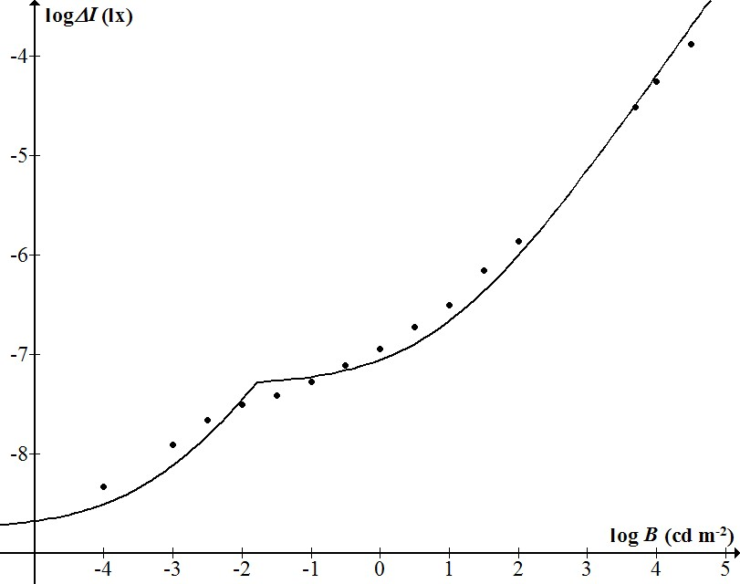
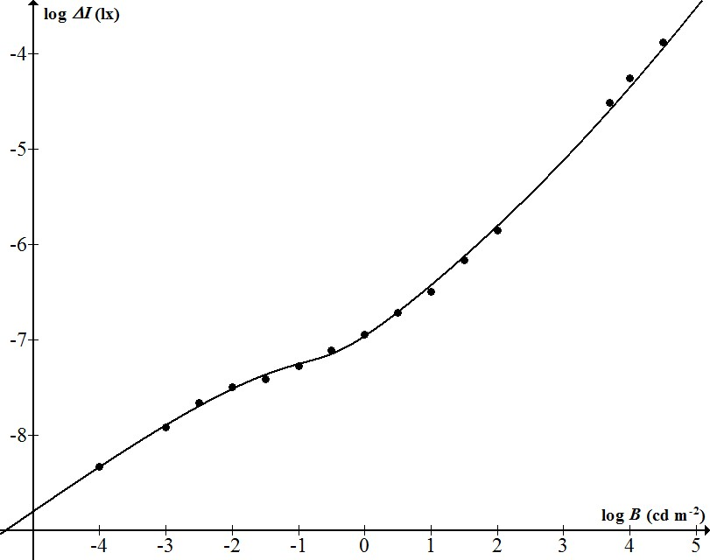
Need for a better model (data from Knoll et al)
Hecht (1947)
Crumey (2014)

Slide 6
Quantities and units
Lighting engineering
Luminance B (cd/m²)
Illuminance I (lx)
Astronomy
Surface brightness S
(mag/arcsec²)
(Apparent) magnitude m (mag)
m₁ – m₂ = 2.5log(I₂/I₁)
defined with respect to some response function:
CIE 1924 or Johnson V

Slide 7
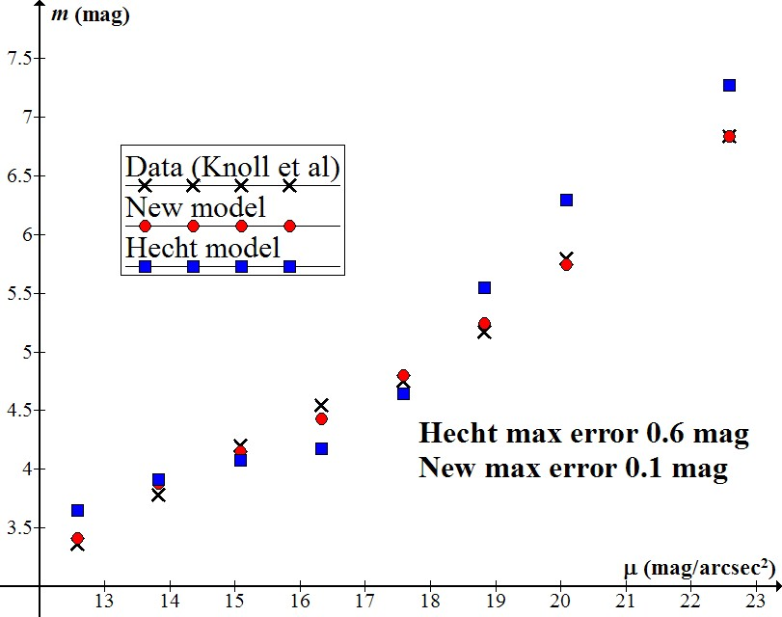

Slide 8
Features of new model
Applicable to various laboratory data sets (not tailored to any one in particular)
More accurate than earlier models
Valid for both point- and extended-sources
Valid for all light levels

Slide 9
The method
Find a mathematical model for visibility data obtained in laboratory studies
Find how to adjust for sky viewing (SPD, S/P ratio, colour index, field factors...)
Find how to adjust for telescopic viewing
Test against existing astronomical observations

Slide 10
Visibility depends on contrast
Chromaticity (colour)
Luminance (surface brightness)

Slide 11
Here concerned with luminance contrast
Targets/backgrounds are achromatic or
Vision is colourless (scotopic – rods only)
B
Increment: ΔB = B_{t}-B
Contrast: C = ΔB/B
B_{t}

Slide 12
Visibility depends on size and luminance
(for uniform targets of constant shape).

Slide 13
Blackwell (1946)
Uniform circular target projected on illuminated screen.
Target in one of several possible positions.
Subjects indicate position using a keypad.
Threshold defined as 50 per cent success.
Threshold C found as a function of background luminance B and target size A.

Slide 14
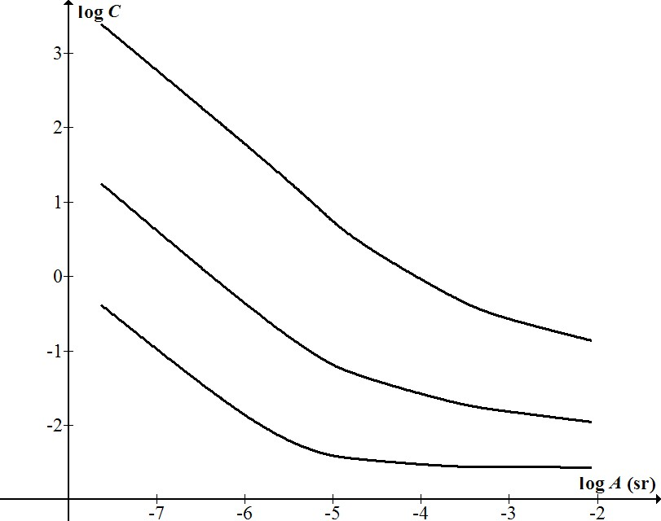
Darker levels require higher contrast.
Small targets require higher contrast to be visible;
Low-contrast targets need to be large enough;
Very dark (scotopic)
Twilight (mesopic)
Daylight
(photopic)

Slide 15
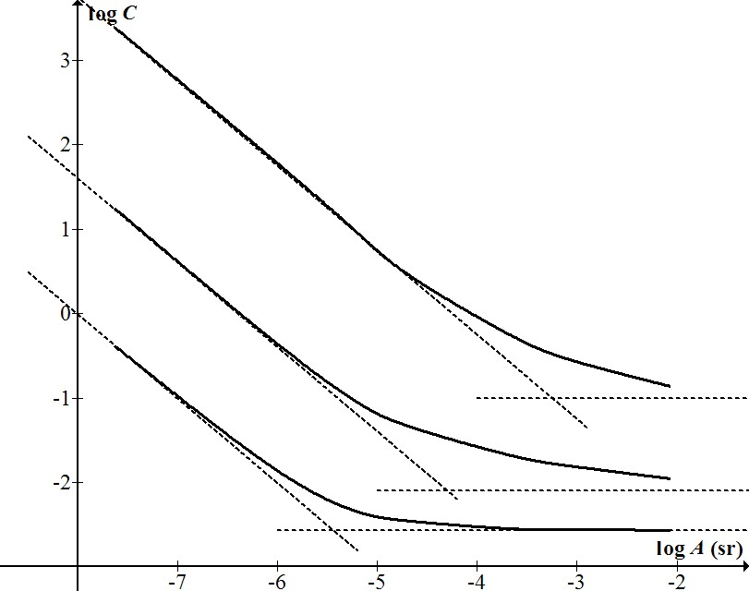
Curves are asymptotic at both ends
Gradient 0
Gradient -1

Slide 16
C=const(B)
CA=const(B)

Slide 17
Strategy
Find asymptote equations (as functions of B).
Smoothly glue the low/high asymptotes.
Result:
Asymptotes are simple functions of B^{-1/4}
C = (low^{q} + high^{q})^{1/q}

Slide 18
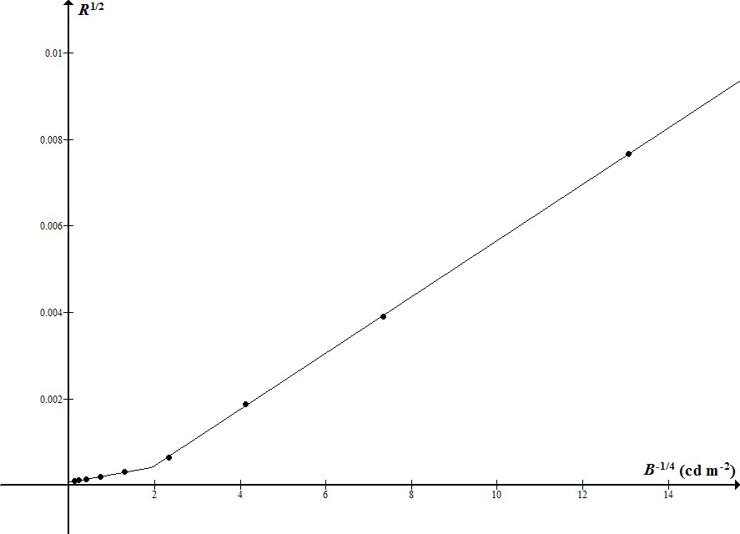

Slide 19
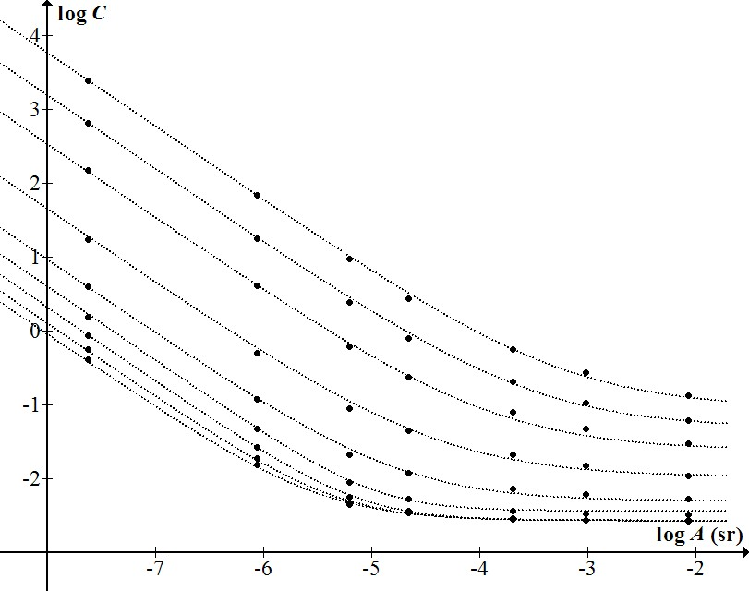

Slide 20
Astronomical Observation
Lack of rigorous studies of naked-eye viewing (further work needed).
Rigorous telescopic data exists.

Slide 21
Viewing through a telescope
Area A increased by magnification
Background B darkened by magnification and light loss
Field factors (user, atmosphere, target...) introduce multipliers λC.
Multiple observations enable field factors to be eliminated.

Slide 22
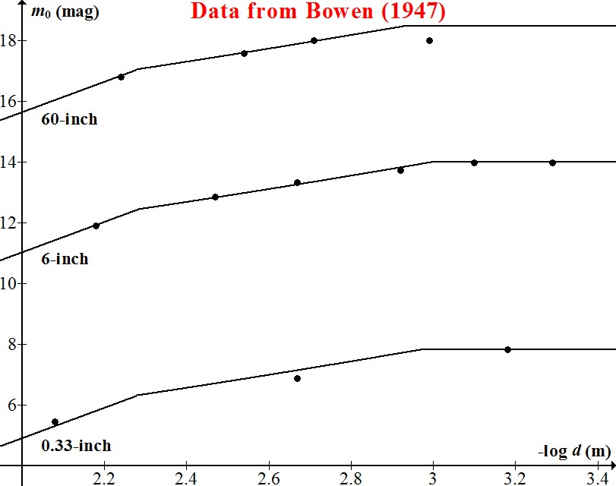

Slide 23
Deductions
Bowen’s pupil diameter: 5.2mm
Mirror reflectance: 85%
Background sky: 21.27 ± 0.06 mag/arcsec².
Zenith sky: 21.6 mag/arcsec² approx.
Sky then was relatively unpolluted.
Light pollution in the area has grown more rapidly than was realised.

Slide 24
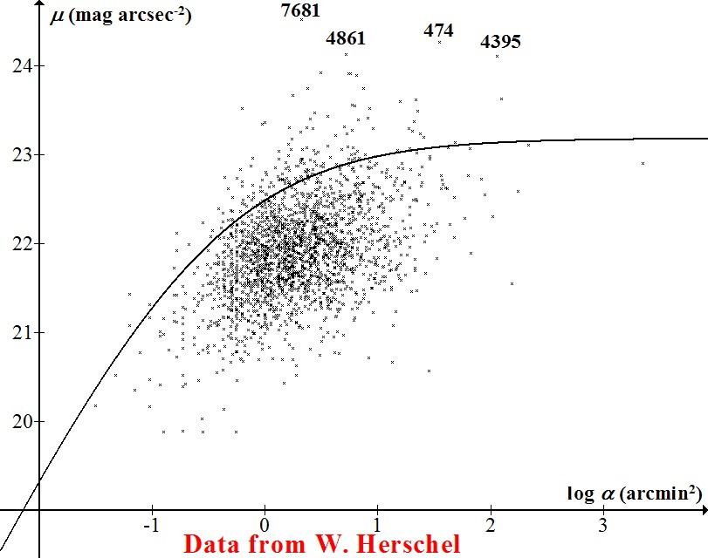

Slide 25
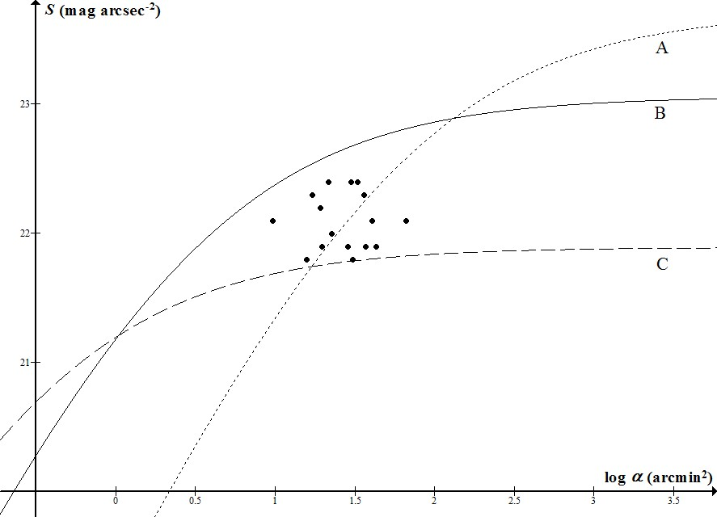

Slide 26
Dark-Sky Classification
Perceptual:
Limiting magnitude
Bortle scale (9 levels)
Instrumental:
IDA (bronze/silver/gold)

Slide 27
Proposal
For the purposes of astronomy...
A “dark” sky is one in which the Milky Way can be seen;
An excessively bright sky is one that does not allow for fully scotopic vision.

Slide 28
